Slide 1
Open Provenance Model Tutorial
Session 5: OPM Emerging Profiles

Slide 2
Session 5: Aims
In this session, you will learn about:
  How to extend OPM through profiles
  The content of a profile
  Four emerging profiles for OPM
  How to get involved with your own profile

Slide 3
Session 5: Contents
Profile Definition
Essential Profiles
  Collections Profile
  Signature Profile
Domain Profiles
  Dublin Core Profile
  D-Profile
Feedback

Slide 4
OPM Layered Architecture

Slide 5
OPM Layered Model
OPM Domain Specialization: Workflow, Web
Technology Bindings: XML, RDF
OPM Essential Profiles: Collections, Attribution
OPM based APIs: record, query
OPM Core
OPM Sig
Notes:
There is some structure behind OPM, and to understand where we go, we need to understand the structure
At the lowest level, the Core OPM model, with the constructs I identified here.
I also anticipate that OPM must specific what signatures are
Some guidelines are also needed to make it a useful model, in terms of collections and attribution
Separately, we need to serialize OPM (so called technology bindings). Currently, we have two proposals for XML and RDF, but others are interesting such as JSON
It then needs to be specialized for domain specific uses. Two important ones: workflow and the Web
Finally, if you believe in the Open Provenance Vision, there are other questions:
How do we assert and record provenance?
How do we query it?
APIs a required for this.

Slide 6
PROFILE DEFINITION

Slide 7
Concept of a Profile
A specialisation of an OPM graph for a specific domain or to handle a specific problem
Profile definitions are welcome!
Note: profile multiplicity challenges inter-operability

Slide 8
What’s in a profile
A unique id
Vocabulary of Annotations
Guidance
Profile Expansion Rules
Syntactical Short-cuts

Slide 9
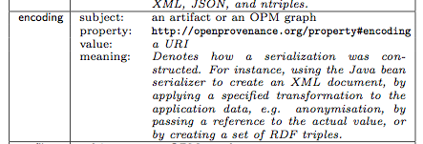

Vocabulary of Annotations
Controlled Vocabulary
Subtyping of edges & nodes
Application specific properties
Easy!
hasPhoto
Reviewer
Review
reviewCreatedBy

Slide 10
Guidance
Many ways to represent the same process within an OPM Graph
System may expect a particular structure or associated vocabulary
Reviewer
Review
reviewCreatedBy
Reviewer
reviewdraft
Publishing
System
Review
submittedReviewFrom
reviewFinalisedFrom
Notes:
Expect different descriptions, or levels of accounts

Slide 11
Profile Expansion Rules
Provide more compact representations of provenance
Maintain OPM Compatibility
PS
draft1
Reviewer
Review
reviewCreatedBy
Rules
Reviewer
reviewdraft
Publishing
System
Review
submittedReviewFrom
reviewFinalisedFrom

Slide 12
Profile Compliance
PROFILE
Id
Vocabulary
Guidance
Expansion directives
Serialisation
Profile Expansion
Profile
Compliant
Graph
Profile-expanded
Graph

Slide 13
Profile Compliance
Profile-expanded
Graph
Profile
Compliant
Graph
OPM Inference
Inferred Graph 2
Inferred Graph1

Slide 14
Syntactic Shortcuts
Allow for parsimony in serializations
Understand how to get back to the OPM model
Paul Groth (Sept 18, 2010): review1, review2 for paper 12
Paul
Groth
r1
P12
Paul
Groth
r2

Slide 15
Profile Summary
OPM is a top level representation
Profiles allow for best practice & usage guidelines
Defining community specific:
  Vocabulary
  Graph structure
  Derivations from vocabulary
  Serializations

Slide 16
Collection Profile

Slide 17

http://www.flickr.com/photos/stripeyanne/3539864111/sizes/l/in/photostream/

Slide 18
Provenance?
http://www.flickr.com/photos/stripeyanne/3539864111/sizes/l/in/photostream/

Slide 19
Provenance?
http://www.flickr.com/photos/stripeyanne/3539864111/sizes/l/in/photostream/

Slide 20
Provenance?
http://www.flickr.com/photos/stripeyanne/3539864111/sizes/l/in/photostream/

Slide 21
Collection Profile (draft)
with Paolo Missier, Paul Groth and Simon Miles
Notion of collection (a kind of artifact)
Collections can be nested
Process types: constructor and artifact
Edge types: contained, wasPartOf, wasIdenticalTo
Completion guidance to derive dependencies on elements from collections

Slide 22
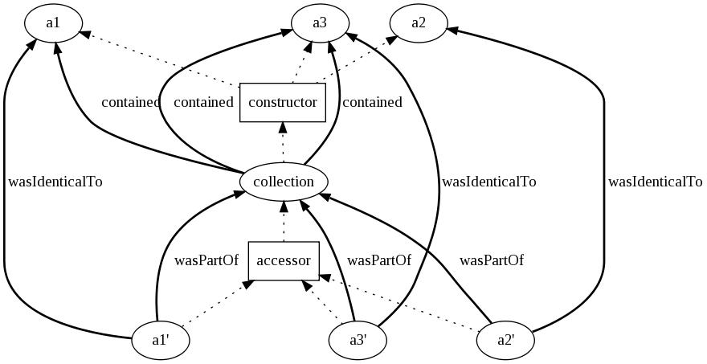
Collections

Slide 23
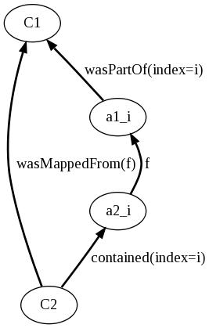
Collections
From
  c2->c1, a1i->c1
derive
  a2i->a1i , c2->a2i
And likewise from
  c2->c1, c2->a2i

Slide 24
SIGNATURE PROFILE

Slide 25
Some Provenance Security Concerns
How can we ensure the integrity of an OPM graph?
  Has it been tampered with? Is it authentic?
Who created an OPM graph?
  Is there non-repudiable evidence that an entity is its author?
Note: many other security requirements, cf. [Tan 06], [Braun 08], [Moreau 10].

Slide 26
Signature of OPM Graphs
Cryptographic signatures provide:
  Non repudiable evidence
  Means to check authenticity
Leveraging existing standards, e.g. XML-Signature
Need to define a “normal form” for XML OPM graph before applying XML-Signature
Implementation available from opm toolbox

Slide 27
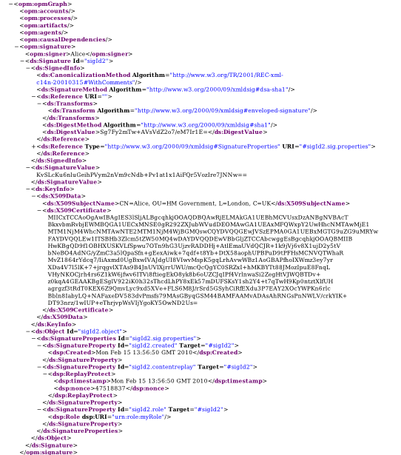
Attribution and Signatures
Embedded Signature
Distinguished Name
X509 Certificate
An annotation to an OPM graph that contains a signature
Timestamp and
Replay Protection
Role
Notes:
It is crucial to have some information about who makes provenance assertions, it can help a reasoner to decide whether provenance is authoritative or whether it can be trusted
OPM does not say how to do this, but it offers the framework to express it.
Currently two independent efforts by Jim and team and myself, which should be consolidated in an agreed profile.
As an illustration here, you see a serialization of an OPM graph, with an explicit signature, here xml signature
For those of you familiar with this technology, this is an embedded signature
It has an explicit X509 certificate with a distinguished name, here it’s Alice’s certificate
With in addition, Signature Properties
with timestamp and nonces to protect against replays
Role (as understood by XML Signature Properties), which would be a way of capturing the capacity under which the signer acted, which I think was one of the requirements John indicated last week.
Note that there is work by Simon Miles about related attribution-like provenance (as in dublin core) to OPM. This is complementary, and over time, we should integrate these approaches in a coherent manner.
Adding signature is not a trivial if we want to do this in a portable manner, and this raises challenging problem if we want to do it, for different serialization technologies such as XML or RDF

Slide 28
Alternative implementation
J. Myers (NCSA) implementation on top of RDF serialization
More challenging since:
  There is no standard way of serializing RDF
  There is no standard RDF-Signature

Slide 29
Dublin Core PROFILE

Slide 30
Dublin Core Profile (draft)
with Simon Miles and Joe Futrelle
To many people, provenance is primarily about attribution, citation, bibliographic information
DC provides terms to relate resources to such information
DC profile aims to use of Dublin Core terms to OPM concepts and graph patterns
http://twiki.ipaw.info/pub/OPM/ChangeProposalDublinCoreMapping/dcprofile.pdf

Slide 31
Dublin Core Terms
Accrual method
Available
Bibliographic citation
Contributor
Publisher
Date
Version
…

Slide 32
dc:accuralMethod
The method by which items are added to a collection
I dc:accuralMethod M
Collection Before
Method
(M)
New item (I)
Addition
dc:versionOf
New Collection

Slide 33
dc:publisher
state=unpublished
A1
used
publish
Ag
P
wasSameResourceAs
wasActionOf
person
name=Luc
wasGeneratedBy
A2
state=published

Slide 34
OPM benefit: refinement
state=unpublished
A1
review
used
publish
Ag
P
approve
wasSameResourceAs
wasActionOf
person
name=Luc
catalog
wasGeneratedBy
A2
state=published

Slide 35
dc:contributor
Ag
A1
used
contribution
P
dc:isVersionOf
wasGeneratedBy
A2
Notes:
An entity responsible for making contributions to the resource

Slide 36
OPM benefit: additional details
Ag
A1
used
Contribution
content
contribution
P
dc:isVersionOf
used
wasGeneratedBy
A2
Notes:
An entity responsible for making contributions to the resource

Slide 37
D-Profile

Slide 38
Provenance Across Applications
Application
Application
Application
Application
Application
Provenance Inter-Operability Layer
The Open Provenance Model (OPM)

Slide 39
OPM Usage Thus Far
OPM has been used for integration between monolithic systems
Assumptions:
  Agreement between applications on integration points
  Little communication mostly through the environment
  Clear demarcation of functional components
  The other party is “a good guy”

Slide 40
OPM in Distributed Systems
Is OPM suitable for Distributed Systems?
Can OPM deal with…
  asynchronous / synchronous systems
  failure, corruption, errors
  transient processes
  independent processes
  defining applications across systems
Notes:
We say that opm is good for distributed systems…. Is it?

Slide 41
OPM in Distributed Systems
Is OPM suitable for Distributed Systems?
Can OPM deal with…
  asynchronous / synchronous systems
  failure, corruption, errors
  transient processes
  independent processes
  defining applications across systems
YES! (but we need some additions)
Notes:
We say that opm is good for distributed systems…. Is it?

Slide 42
D-PROFILE
A profile for modeling distributed systems within OPM
Message-passing model
Examples:
  Web services
  Pervasive systems
  Mobile

Slide 43
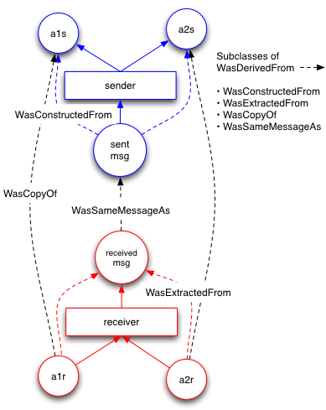
Guidance: communication

Slide 44
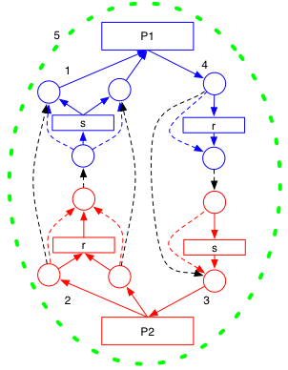
Vocabulary
Edges
WasConstructedFrom
WasCopyOf
WasSameMessageAs
WasExtractedFrom
Properties
attributedTo
tracer
Notes:
AttributedTo goes with an account (in this case a color)
Green on second figure denotes a tracer also a property of each node an edge

Slide 45
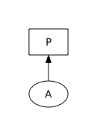
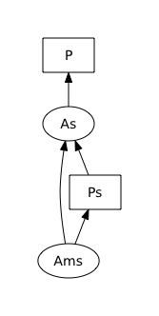
Compact Representation
Subclass of Artifact a D-Artifact
Has annotations including:
  Payload for sender & receiver
  A message id
  Tracers
  Attribution
Expansion Rules
Save roughly half the nodes & edges

Slide 46
FEEDBACk: What profiles are missing??

Slide 47
Extend OPM through a Profile
Any one can make a profile (Go for it!)
Easiest route is through a Vocabulary
Post to the wiki and gain a community following
  Can also become endorsed…
Lightweight Governance Model
  http://twiki.ipaw.info/pub/OPM/WebHome/governance.pdf

